Slide 1

Mepco Schlenk Engineering College (Autonomous)
19CS694 – WEB USER INTERFACE DESIGN
HOSPITAL MANAGEMENT SYSTEM
KAILASINI A (Reg. No. :202104053)
MADHUMITHA N (Reg. No. : 202104074)
Department of Computer Science and Engineering
1

Slide 2
Mepco Schlenk Engineering College (Autonomous)
Problem Description:
Existing systems for hospital management can be complex and difficult to navigate, hindering staff efficiency. Patient data might be scattered across different systems, making it difficult to access complete medical records. Manual processes and lack of integration can slow down administrative tasks and appointment scheduling. Furthermore, patient data is frequently fragmented across various platforms, making it difficult to access complete medical records for informed decision-making
25 April 2024
25 April 2024
25 April 2024
25 April 2024
25 April 2024
25 April 2024
25 April 2024
Department of Computer Science and Engineering
2

Slide 3
Mepco Schlenk Engineering College (Autonomous)
OBJECTIVE:
The main objective of this system is:
To develop a user-friendly hospital management system that integrates patient data, automates workflows, and improves communication.
To design a system reduce administrative burdens by automating tasks and standardizing procedures.
To design an intuitive and accessible interface tailored to the needs of healthcare professionals
25 April 2024
25 April 2024
25 April 2024
25 April 2024
25 April 2024
25 April 2024
25 April 2024
Department of Computer Science and Engineering
3

Slide 4
Mepco Schlenk Engineering College (Autonomous)
OUTCOME:
The system can facilitate communication and collaboration among healthcare professionals involved in a patient's care, leading to better coordination and optimized treatment plans.
Improved care delivery and a more user-friendly experience for patients can lead to higher satisfaction with the hospital services.
Efficient appointment scheduling and communication channels can minimize patient waiting times and enhance the overall patient experience.
25 April 2024
25 April 2024
25 April 2024
25 April 2024
25 April 2024
25 April 2024
25 April 2024
Department of Computer Science and Engineering
4

Slide 5
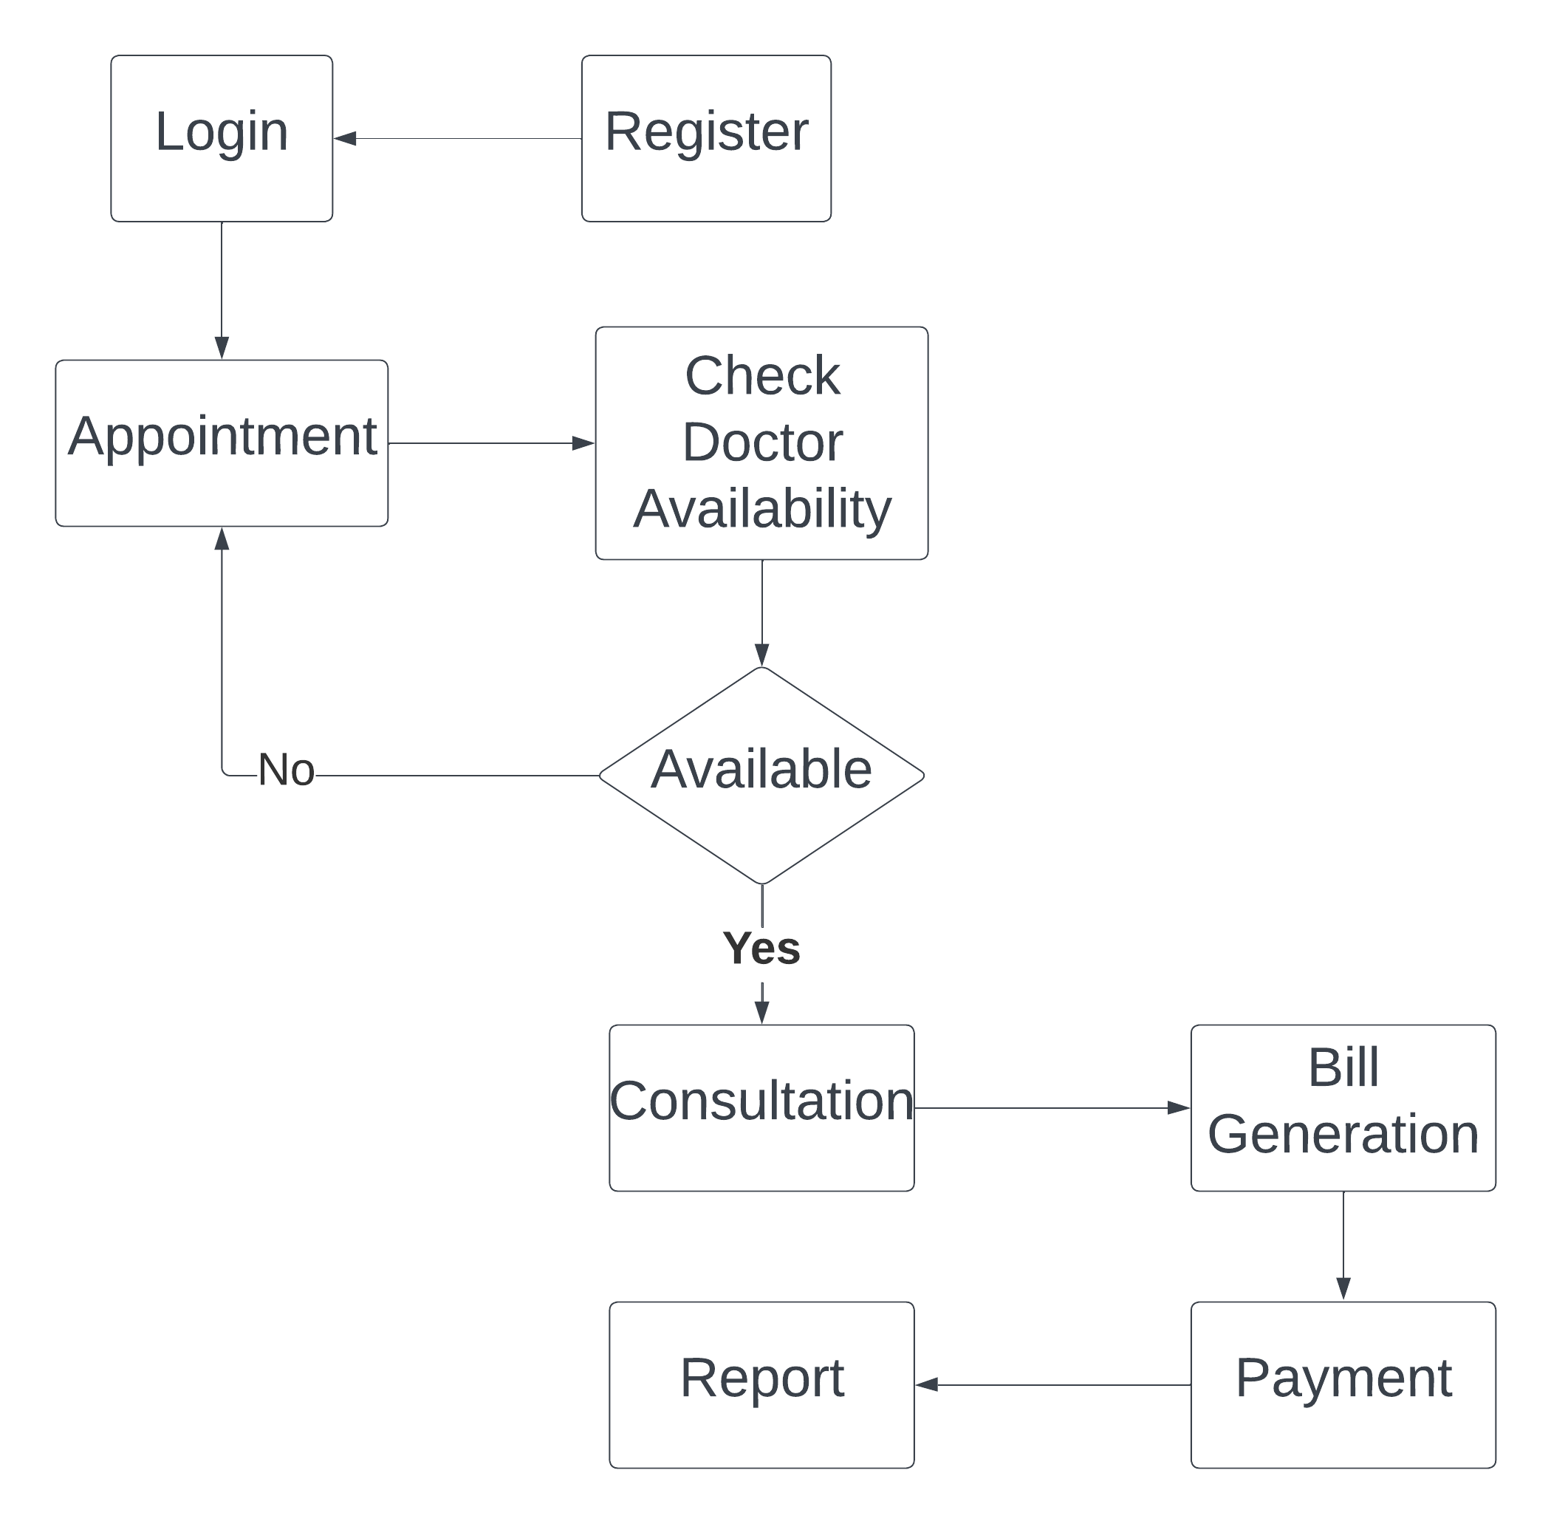
Mepco Schlenk Engineering College (Autonomous)
ARCHITECTURE DESIGN:
Department of Computer Science and Engineering
5

Slide 6
Mepco Schlenk Engineering College (Autonomous)
Modules:
Listed below gives a description of database document schemas used for the HOSPITAL MANAGEMENT SYSTEM
Login
Add Patient
Add Doctor
Book appointment
View Doctor
25 April 2024
25 April 2024
Department of Computer Science and Engineering
6

Slide 7
Mepco Schlenk Engineering College (Autonomous)
Make payment
Prescription
Bill Generation
View payment
Inactivate doctor account
25 April 2024
25 April 2024
25 April 2024
Department of Computer Science and Engineering
7

Slide 8
Mepco Schlenk Engineering College (Autonomous)
User Table –Login Page
Attribute Name | Type | Constraint(s) | Description
User Name | String | [A-Za-z] | Username set by the Admin
Password | String | Minimum 6 characters | Password set by the Admin
25 April 2024
25 April 2024
Department of Computer Science and Engineering
8

Slide 9
Mepco Schlenk Engineering College (Autonomous)
User Table – Add patient Page
Attribute Name | Type | Constraint(s) | Description
Name | String | ### | Name of the Patient
Age | Integer | ### | Age of the Patient
Email id | String | ##@gmail.com | Email of the Patient
Phone Number | Integer | 10 digits | Phone Number of the Patient
Gender | String | Male, Female. | Gender of the Patient
Address | String | ### | Address of the patient
Password | String | Minimum 6 characters | Password of patient
25 April 2024
25 April 2024
Department of Computer Science and Engineering
9

Slide 10
Mepco Schlenk Engineering College (Autonomous)
User Table – Add Doctor Page
Attribute Name | Type | Constraint(s) | Description
Name | String | ### | Name of the Doctor
Specialization | String | ### | Specialization of the doctor
Email id | String | ##@gmail.com | Email of the doctor
Phone Number | Integer | 10 digits | Phone Number of the doctor
Address | String | ### | Address of the patient
Password | String | Minimum 6 characters | Password of doctor
25 April 2024
Department of Computer Science and Engineering
10

Slide 11
Mepco Schlenk Engineering College (Autonomous)
User table –Book appointment
Attribute Name | Type | Constraint(s) | Description
Patient email | String | ###@gmail.com | Email of the patient
Doctor email | String | ###@gmail.com | Email of the patient
Date | String | Upcoming dates only can be booked | Date of the appointed can be booked
Appointment time | String | ### | Date can be selected
Reason | String | ### | Reason for booking appointment
25 April 2024
25 April 2024
Department of Computer Science and Engineering
11

Slide 12

Mepco Schlenk Engineering College (Autonomous)
User table –View Appointments
Attribute Name | Type | Constraint(s) | Description
Doctor name | String | ### | Name of the patient
Date | String | ### | Date of appointment
Time | String | ### | Time for appointment
Reason | String | ### | Reason for appointment
Status | String | ### | Status of the appointment
25 April 2024
Department of Computer Science and Engineering
12

Slide 13
Mepco Schlenk Engineering College (Autonomous)
User table –Prescription
Attribute Name | Type | Constraint(s) | Description
Email | String | ###@gmail.com | Email of patient
Email | String | ###@gmail.com | Email of the patient
Prescription | String | ### | Prescription for the patient by the doctor
25 April 2024
25 April 2024
25 April 2024
Department of Computer Science and Engineering
13

Slide 14
Mepco Schlenk Engineering College (Autonomous)
User table –Doctor Appointments
Attribute Name | Type | Constraint(s) | Description
Patient name | String | ### | Name of the patient
Date | String | ### | Date of appointment
Time | String | ### | Time for appointment
Reason | String | ### | Reason for appointment
25 April 2024
Department of Computer Science and Engineering
14

Slide 15
Mepco Schlenk Engineering College (Autonomous)
LOW LEVEL DESIGN
Login Details:
Files used | Login.ts, Login.html, Login.css
Short Description | Allows the user to login to the application
Arguments | Email, Password
Return | Success/Failure in login
Pre-Condition | The user must have an account
Post-Condition | The home page will be displayed
Actor | Patient, Admin, Doctor.
25 April 2024
Department of Computer Science and Engineering
15

Slide 16
Mepco Schlenk Engineering College (Autonomous)
LOW LEVEL DESIGN
Add Patient Details
Files used | AddPatient.ts,AddPatient.html, AddPatient.css
Short Description | Allows the admin to add patient to the application
Arguments | Email, Name, Phoneno, Gender, Password
Return | Success/Failure in adding patient
Pre-Condition | The admin must have an account
Post-Condition | The Adding patient will be displayed
Actor | Admin.
25 April 2024
Department of Computer Science and Engineering
16

Slide 17
Mepco Schlenk Engineering College (Autonomous)
LOW LEVEL DESIGN
Add Doctor Details
Files used | Adddoctor.ts, Adddoctor.html, Adddoctor.css
Short Description | Allows the admin to add doctors to the application
Arguments | Email, Name, Phoneno, Password
Return | Success/Failure in adding doctor
Pre-Condition | The admin must have an account
Post-Condition | The Adding Doctor will be displayed
Exception | Email and password
Actor | Admin.
25 April 2024
Department of Computer Science and Engineering
17

Slide 18
Mepco Schlenk Engineering College (Autonomous)
LOW LEVEL DESIGN
Book appointment Details
Files used | Bookappoint.ts, Bookappoint.html, Bookappoint.css
Short Description | Allows the patient to book the appointment
Arguments | Date, Time, Reason, Email of the patient and doctor.
Return | Success/Failure in Booking appointment
Pre-Condition | The patient must have an account
Post-Condition | The appointment booked will be displayed
Actor | Patient
25 April 2024
Department of Computer Science and Engineering
18

Slide 19
Mepco Schlenk Engineering College (Autonomous)
LOW LEVEL DESIGN
Add Prescription Details
Files used | Prescription.ts, Prescription.html, Prescription.css
Short Description | Allows the doctors to enter the prescription for the patient
Arguments | Date, Time, Reason, Email of the patient
Return | Success/Failure in Prescription
Pre-Condition | The doctor must have an account
Post-Condition | The prescription for the patient will be displayed
Actor | Doctor.
25 April 2024
25 April 2024
Department of Computer Science and Engineering
19

Slide 20

Mepco Schlenk Engineering College (Autonomous)
RESULTS: Home Page
25 April 2024
Department of Computer Science and Engineering
Department of Computer Science and Engineering
20

Slide 21
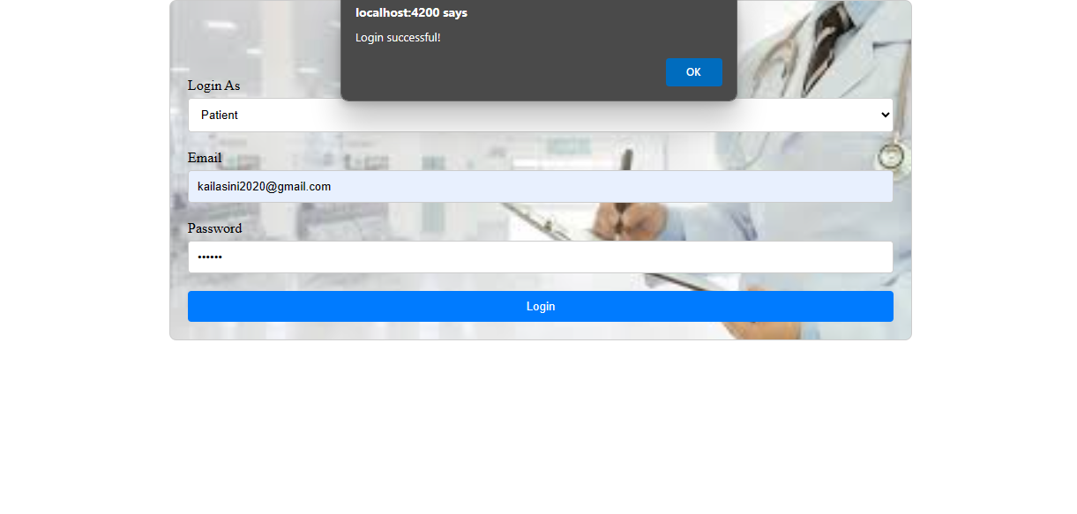
Mepco Schlenk Engineering College (Autonomous)
RESULTS: Login Page
25 April 2024
Department of Computer Science and Engineering
21

Slide 22
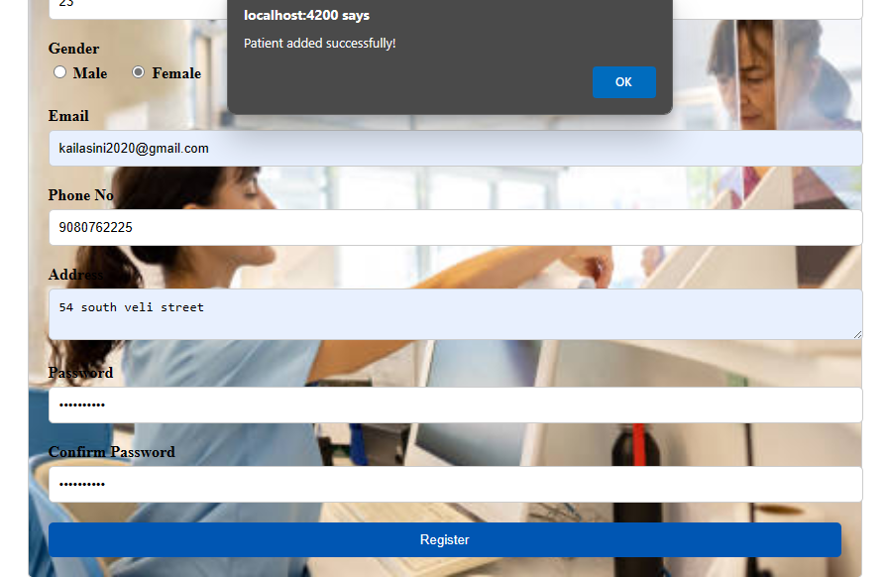
Mepco Schlenk Engineering College (Autonomous)
RESULTS: Add patient Page
25 April 2024
Department of Computer Science and Engineering
22

Slide 23
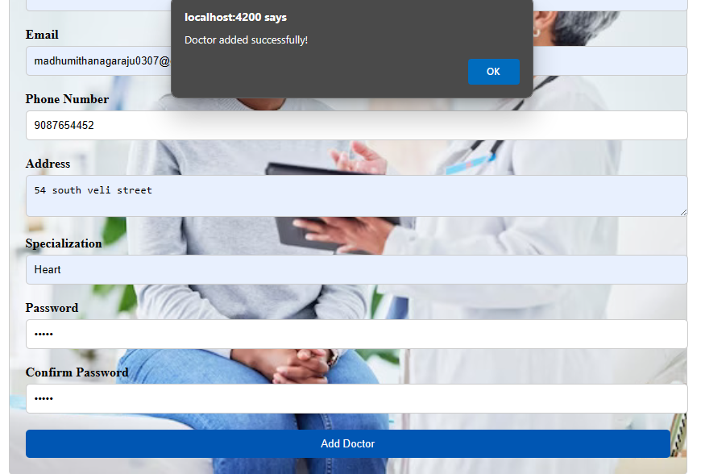
Mepco Schlenk Engineering College (Autonomous)
RESULTS: Add Doctor Page
Department of Computer Science and Engineering
23

Slide 24
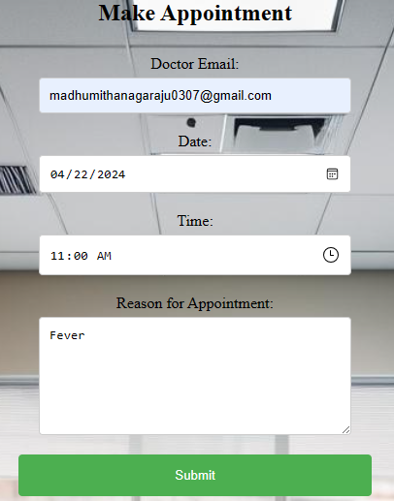
Mepco Schlenk Engineering College (Autonomous)
RESULTS: Book appointment page
25 April 2024
25 April 2024
25 April 2024
Department of Computer Science and Engineering
24

Slide 25
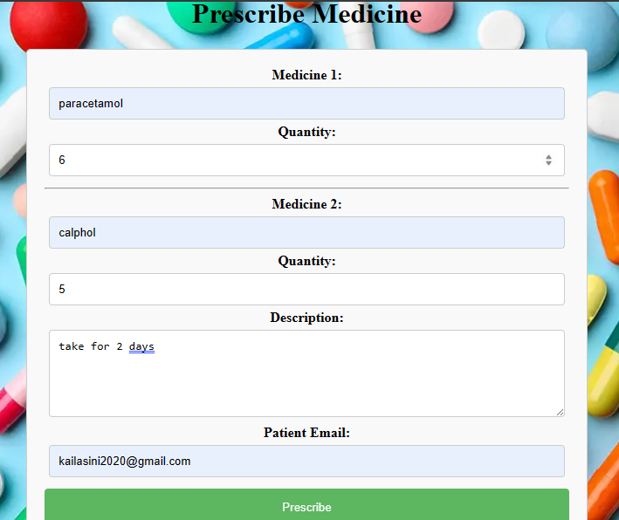
Mepco Schlenk Engineering College (Autonomous)
RESULTS: Prescription page
25 April 2024
Department of Computer Science and Engineering
25

Slide 26
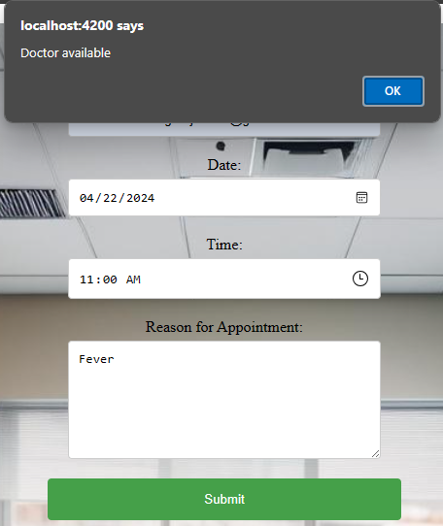
Mepco Schlenk Engineering College (Autonomous)
RESULTS: Check Appointment page
25 April 2024
Department of Computer Science and Engineering
26

Slide 27
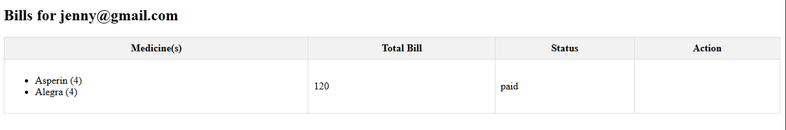
Mepco Schlenk Engineering College (Autonomous)
RESULTS: Bill Generation page
25 April 2024
Department of Computer Science and Engineering
27

Slide 28
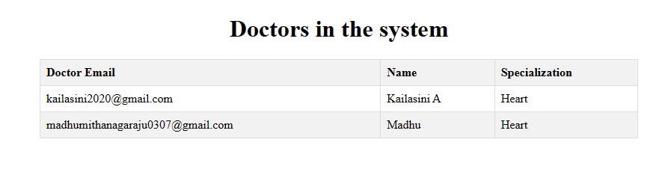
Mepco Schlenk Engineering College (Autonomous)
RESULTS: View Doctor page
25 April 2024
25 April 2024
Department of Computer Science and Engineering
28

Slide 29
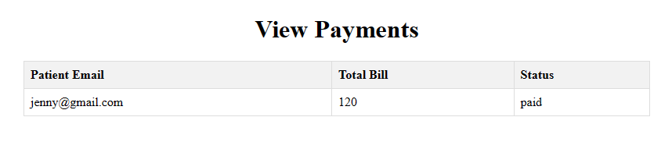
Mepco Schlenk Engineering College (Autonomous)
RESULTS: View Payment page
25 April 2024
25 April 2024
25 April 2024
Department of Computer Science and Engineering
29

Slide 30
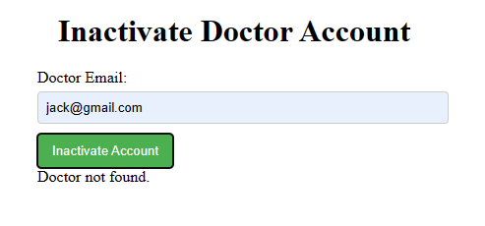
Mepco Schlenk Engineering College (Autonomous)
RESULTS: Inactivate Doctor Account page
25 April 2024
25 April 2024
25 April 2024
25 April 2024
Department of Computer Science and Engineering
30

Slide 31
Mepco Schlenk Engineering College (Autonomous)
THANK YOU
25 April 2024
25 April 2024
25 April 2024
25 April 2024
25 April 2024
25 April 2024
25 April 2024
Department of Computer Science and Engineering
31

